Slide 1
Multiagent Systems and Organizations
Lukáš Kúdela Prof. RNDr. Petr Štěpánek, DrSc. Version: 0.000001 Date: 2011-11-03

Slide 2
Agent
An agent is a computer system that is situated in some environment, and that is capable of autonomous action in this environment in order to meet its delegated objectives.
Intelligent agents also have these capabilities:
Reactivity – ability to perceive their environment, and respond in a timely fashion to changes that occur in it
Proactiveness – ability to exhibit goal-directed behaviour by taking the initiative
Social ability – capability to interact with other agents

Slide 3
Autonomous Agent
An autonomous agent is a system situated within and a part of an environment that senses that environment and acts on it, over time, in pursuit of its own agenda and so as to effect what it senses in the future.
Essential properties:
Reactive – responds in a timely fashion to changes in the environment
Pro-active (goal-oriented) – does not simply act in response to the environment
Autnomous – exercises control over its own actions
Temporally continuous – is a continuously sunning process
Other properties:
Social – communicates with other agents, perhaps including people
Learning – changes its behaviour based on its previous experience
Mobile – able to transport itself from one machine to another
Flexible – actions are not scripted
Character – believable “personality” and emotional state

Slide 4
Multiagent System
Multiagent system (MAS) is a system composed of multiple interacting agents.
Direct interaction – via messages
Indirect interaction – via environment
Multi-agent system evolved into Multiagent System ☺
“Multi-agent” = Multiple standalone agents
“Multiagent” = Multiple interacting agents

Slide 5
Problem Solving using Organizations
Consider a problem with the following properties.
It can easily be decomposed into well-define sub-problems.
These sub-problems can be solved independently.
In concurrent (parallel or distributed) fashion.
Imagine how a human organization would go about solving the given problem.
Model this human organization as a MAS.
This approach is very intuitive. ☺
However, we are not quite there yet. ☹

Slide 6
Poor Model Problem
No single agreed-upon (standard) notion of organization currently exists in the field of MAS!
In plain vanilla MAS, every agent can (in principle) talk to/with any other agent.
Regardless of whether this is desirable or even allowed in the modelled organization.
This is seldom the case in real world organizations.

Slide 7
Real World Organizations
All organizations but the simplest ones are structured into sub-organizations (branches, divisions, departments, etc.).
These are full-fledged organizations on their own, i. e. they can be further broken down.
Organizations define roles and interaction protocols.

Slide 8
Organization-Centric Concepts - Organization
An organization is a an organized group of agents, which imposes rules on the mutual interaction of its members. ☺

Slide 9
Organization-Centric Concepts - Role
An organization defines roles.
A role is an interface between the organization and its members.
The organization interacts with its members via their roles.
The members of an organization interact with each other via their roles.
A role is a collection of requirements, responsibilities and powers.
A particular role always exists within the context of its defining organization.

Slide 10
Organization-Centric Concepts – Interaction Protocol
Interaction protocol (or Communication protocol) is a set of rules defining all possible interaction scenarios (or communication scenarios) between two or more roles within an organization.
This way, the concrete interacting agents are abstracted.
Interaction scenario (or Communication scenario) is a sequence of actions performed (or messages exchanged) by two or more roles within an organization.

Slide 11
Poor Model Problem – Solution?
Many MAS design methodologies employ organization-related concepts.
Unfortunately, these are used only at the conceptual level to enable the modeller to reason about the system.
The only artifacts eventually produced by these methodologies at the logical level are good-old agents.
Organization-centric concepts are not first-class citizens at the logical (platform-independent) level.
Let alone on the physical (platform-dependent) level.

Slide 12
Poor Model Problem – Solution!
Design a custom MAS platform that supports organizations.
MadKit and its metamodel Aalaadin/AGR
Ferber, Gutknecht
http://www.madkit.org/
Extend a generic MAS platform to support organizations.
JadeOrgs - A Jade platform extension
Fischer, Hahn, Madrigal-Mora
powerJade – A Jade platform extension
Baldoni, Boella

Slide 13
AUML
MAS are often characterized as extensions of object-oriented (OO) systems.
This overly simplified view has often troubled system designers as they try to capture the unique features of MAS systems using OO tools.
In response, an agent-based unified modeling language (AUML) is being developed.
http://www.auml.org/

Slide 14
Organization Class vs. Organization Instance
Organization type (class) is a compile-time entity representing a family of organizations with the same role structure.
Analogous to the concept of Class in OOP.
Organization instance is a run-time entity representing a concrete organization.
Analogous to the concept of Instance in OOP.

Slide 15
Role Class vs. Role Instance
Role type (class) is a compile-time entity representing a general role definition.
Analogous to the concept of Organization class.
Role instance is a run-time entity representing a concrete role assignment.
Analogous to the concept of Organization instance.

Slide 16
MetaMAS
Two projects:
JadeOrg
MetaMAS
http://code.google.com/p/metamas/

Slide 17
MAS and Automated Theorem Proving
Distributed theorem proving (DTP)
Inexpensive, heterogeneous computers connected to the Internet forming a distributed environmnet for DTP
Issues:
Task partitioning and load balancing
Communication
Control and monitoring

Slide 18
ATP – Hyper-linking Proof Procedure
Hyper-linking proof procedure (HLPP) was proposed to eliminate the duplication of clauses occurring in many deduction methods.
It is a refutational clause-form deduction method.
It consists of the following two processes:
Hyper-instance generation (HIG)
Propositional satisfiability test (PSAT)

Slide 19
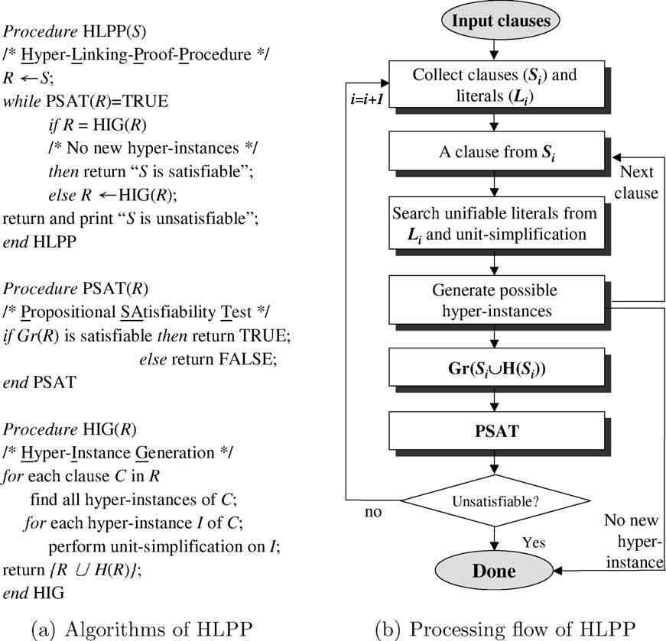
HLPP – HIG and PSAT

Slide 20
HLPP – Computational Model
Levels of parallelism:
Process-level
Clause-level
Literal-level
Analytical considerations:
Task partitioning – task independence
Load balancing – dispatching clauses to PEs
Control and monitoring
Communication

Slide 21
HLPP as MAS – Proof Agents
Proof factory – PE being able to invoke HLPP
Proof agent – resides in proof factory and performs the following tasks:
Invoking HLPP when assigned a proving job
Asking for help when overloaded
Volunteering for help when underloaded
Each proof agent is associated with a knowledge base

Slide 22
HLPP as MAS – System Agents
System agents control and monitor the system.

Slide 23
System agents – Agent Manager
Agent dock
A pool gathering available proof agents
Agent manager
Resides in the Agent dock
Names the agents
Monitors the liveness of the registered agents
Lists the volunteering agents

Slide 24
System agents – Board Cleaner
Blackboard
A place where agents post requests for help and answers to the requests
e. g. to perform HIG or PSAT.
Proof agents can read posts on the Blackboard.
Board cleaner
Takes care of listing volunteers.
Watches the messages posted on the Blackboard and traces their status of being served.

Slide 25
System Agents – Knowledge Manager
Knowledge manager
Installs/updates the latest version of HLPP (version control)
Suggests proper parameters for proof factories (knowledge management)

Slide 26
Agent Interaction
Initiating
Conversion of a problem into a set of clauses
Performance tuning
Posting help requests the Blackboard
Volunteering
Picking up help requests from the Blackboard
Collaboration
Partitioning the set of clauses for collaborators
Data forwarding
Sending the proving job assignment to collaborators
Feeding back
Receiving the proving job results from collaborators

Slide 27
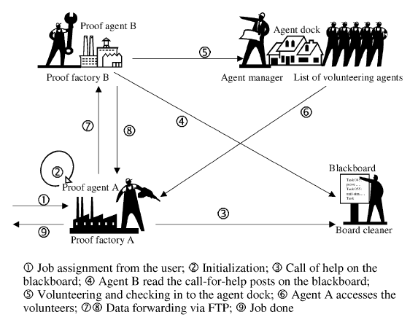
Agent Interaction - Diagram

Slide 28
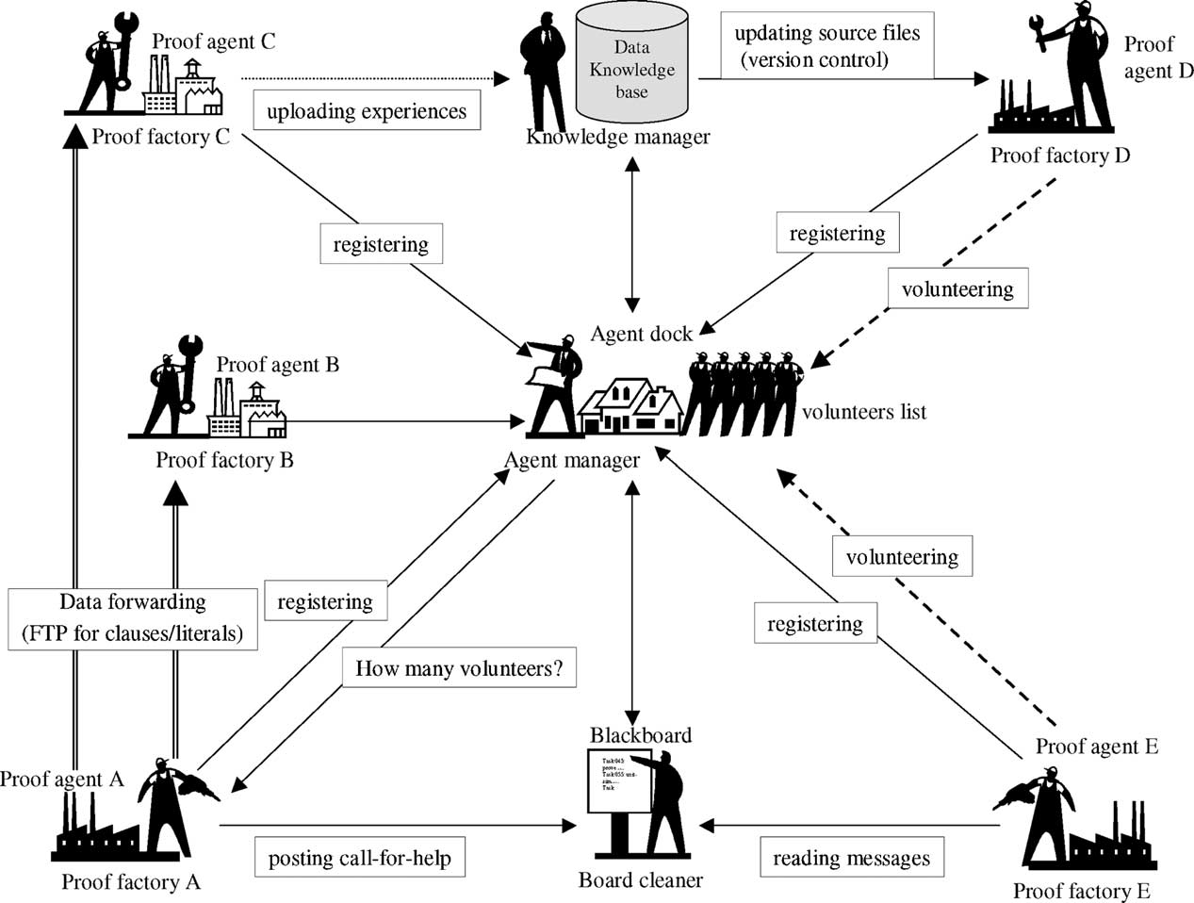
High-level Framework Architecture

Slide 29
References
Wu, C.-H. (2005) A Multi-agent Framework for Distributed Theorem Proving. Expert Systems with Applications, 29(3), 554—565

